Slide 1



Multimodal Deception Detection System
Ain Shams University
Faculty of Computers and Information Sciences
Team members :
Doaa Yehia
Medhat Essam
Mena Ashraf
Mohamed Moawad
Reem Ayman
Rodayna Mohamed
Department:
Computer Science
Supervisors:
Dr. Salsabil Amin
TA. Zeina Rayan

Slide 2

Agenda
Objective
System Architecture
Explanation of finished phases
Description of Datasets
Experiments & Results
Short Demo
What’s next?
Challenges

Slide 3

Objective
We aim in this project to create a Multimodal deception detection web app that integrates information from multiple modalities such as verbal, nonverbal, physiological, and contextual cues to detect deception.

Slide 4
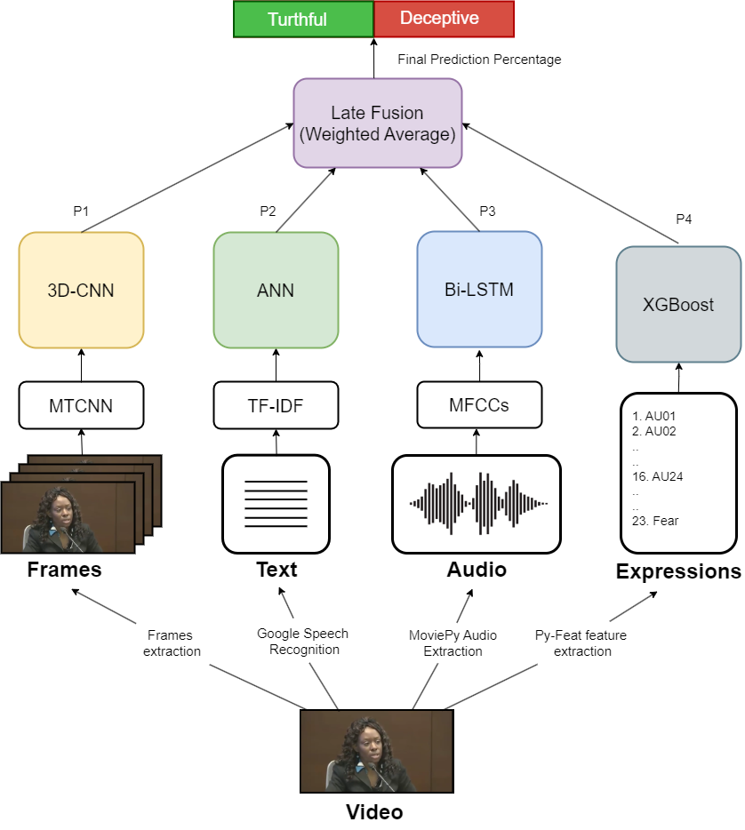
System Architecture
Model Architecture

Slide 5
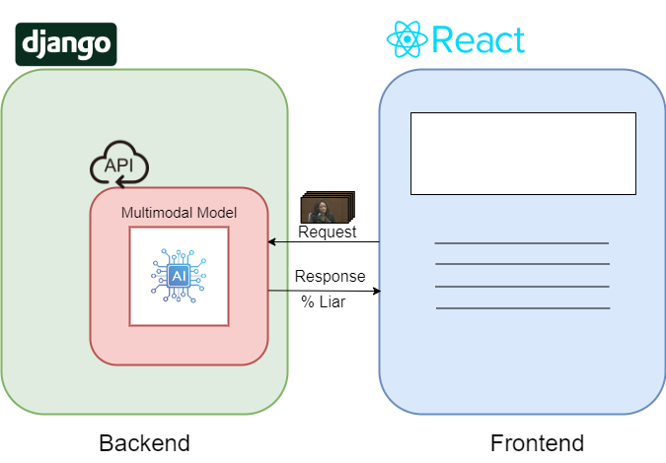
System Architecture (cont.)
Web App Architecture

Slide 6

Explanation of finished phases
Video Modality
Expressions Modality
Text Modality
Audio Modality
Multimodal
Web Application

Slide 7


1. Video Modality
When people lie, they exhibit involuntary expressions and movements.

Slide 8
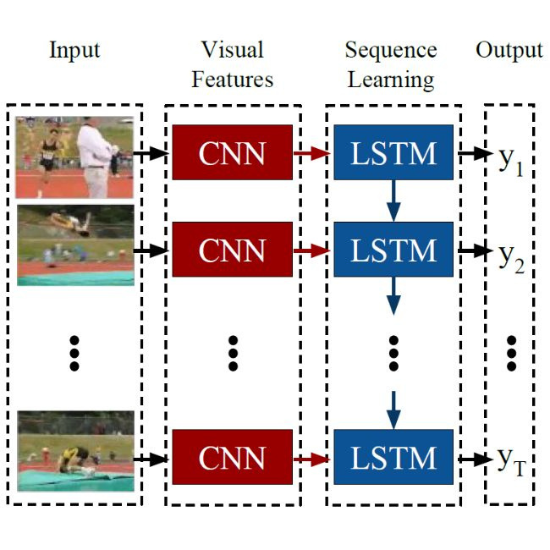
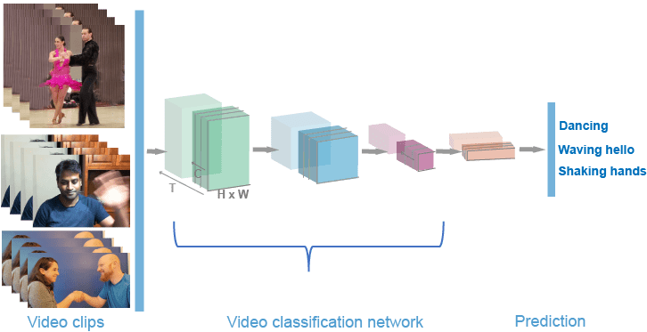
1. Video Modality
Various Neural Networks can be used to identify deception through visual cues across video frames.

Slide 9
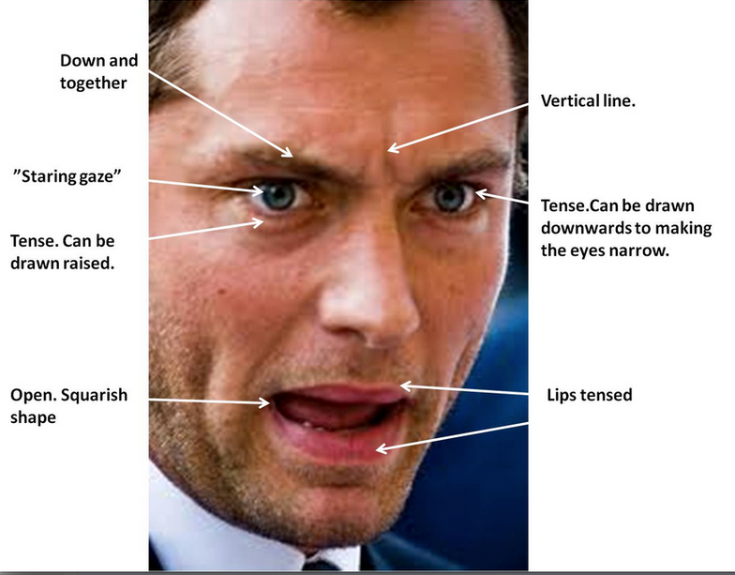
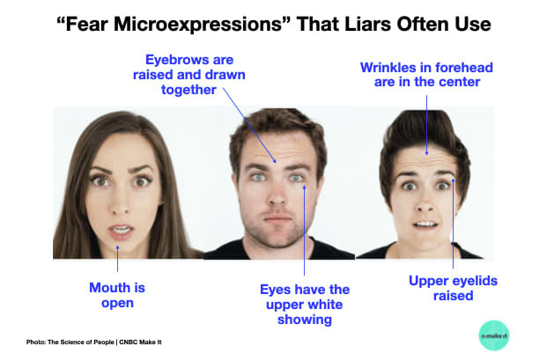
2. Expressions Modality
Micro expressions are brief, involuntary facial expressions that can reveal deception.

Slide 10
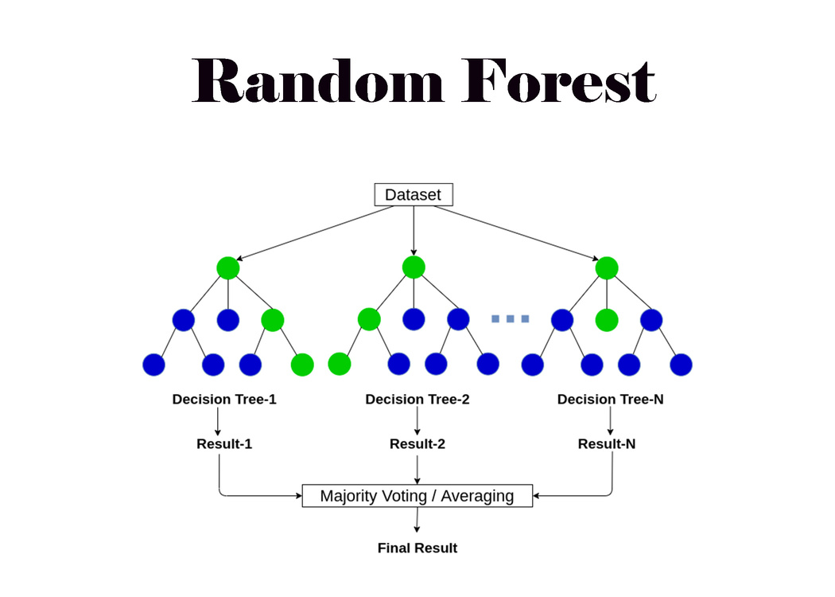
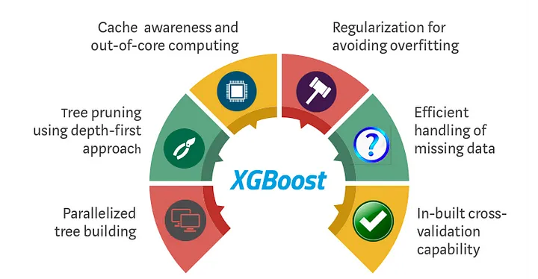
2. Expressions Modality
Machine learning classifiers such as XGBoost and Random Forests help us analyze these subtle cues to detect deception.

Slide 11


3. Text Modality
Linguistic cues such as word choice, syntax variation, and repetition can indicate deception in text.

Slide 12
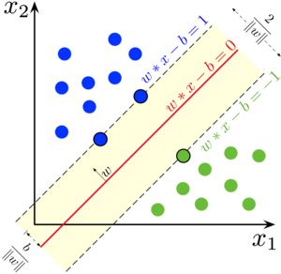

3. Text Modality
We use simple classifiers such as SVMs, and ANNs to detect deceptive patterns in natural language.

Slide 13


4. Audio Modality
Detecting deception through audio involves analyzing vocal cues like pitch, tone, pauses and hesitations.

Slide 14
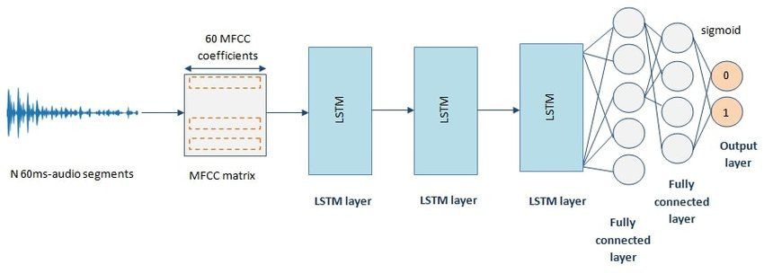
4. Audio Modality
RNNs excel in recognizing patterns and inconsistencies indicative of deception in audio signals.

Slide 15
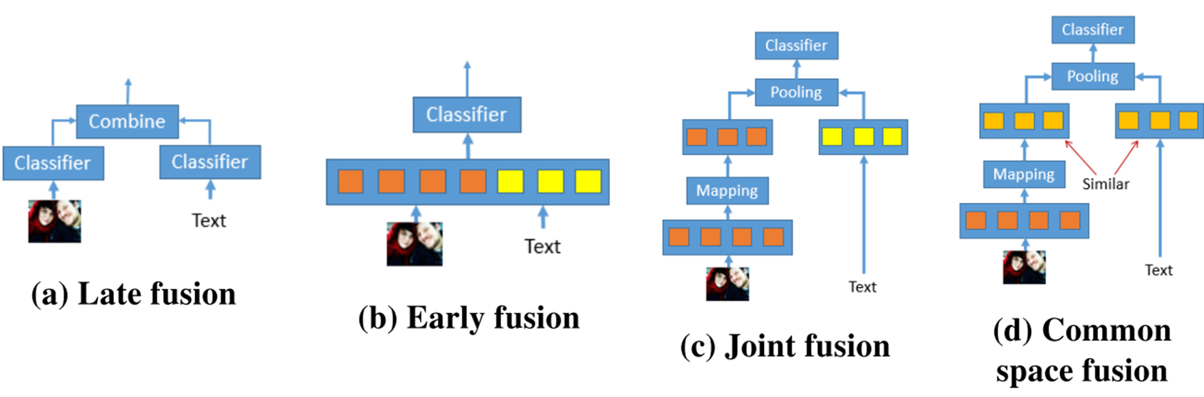
5. Multimodal
Integrating data from multiple sources such as audio, video, and text can create a richer data representation for deception detection.

Slide 16


6. Web Application
The backend is powered by Django, offering a simple API for model integration. The frontend uses React for a straightforward and intuitive user interface.

Slide 17

Description of Dataset

Slide 18
Description of datasets
Real-life Deception Detection Dataset:
The dataset was released in 2015.
It comprises a collection of 121 real-life courtroom trial videos of which 60 are truthful and 61 are deceptive.
The dataset is accompanied by annotations of various gestures and behaviors observed within the videos.

Slide 19
Description of datasets (cont.)
Miami University Deception Detection Database
The dataset was released in 2017.
It contains 320 videos of 80 individuals spanning different racial backgrounds and genders.
This database is accompanied by an excel codebook which includes data related to the videos and subjects in the database.

Slide 20

Experiments & Results

Slide 21
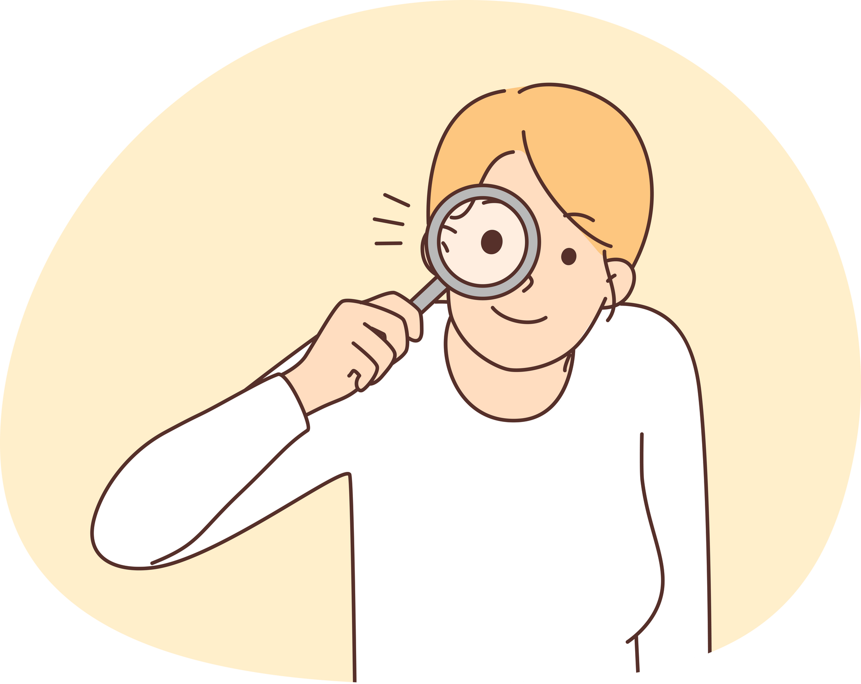
Dataset Choice
Experiments on the Miami University Dataset showed poor results of around 50-55% Accuracy, with a slight improvement in text modality at 70% but overall, it was insufficient for multimodal experimentation.
This is likely due to its data collection method which relied on planned surveys unlike Real-life Dataset which employs natural deception.
Due to these findings, we decided to shift our focus to the Real-life Dataset which is backed by more credible research.

Slide 22
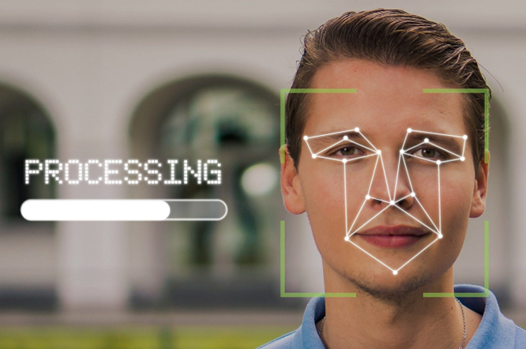
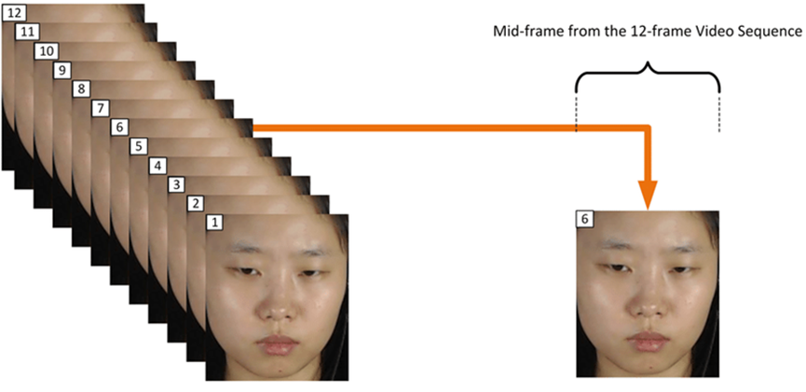
Video Modality Experiments
Video frames are normalized to be of the same sequence length and resolution using OpenCV, and subject faces are cropped.

Slide 23

Video Modality Results
Model Name | Face Detector | Sample Shape | Test Accuracy
3D CNN | Haar Cascade Frontal Face | 100x64x64x1 | 83.33%
CNN-LSTM | Haar Cascade Frontal Face | 100x64x64x1 | 70.83%
3D CNN | MTCNN | 100x64x64x1 | 87.50%
CNN-LSTM | MTCNN | 100x64x64x1 | 79.17%

Slide 24
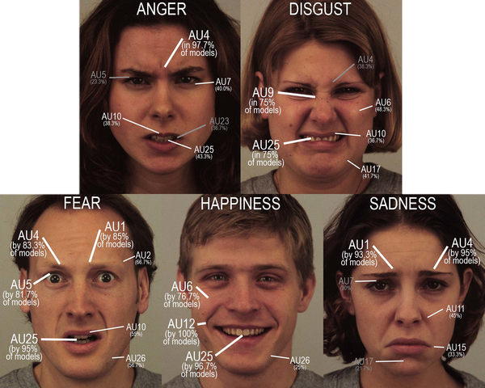
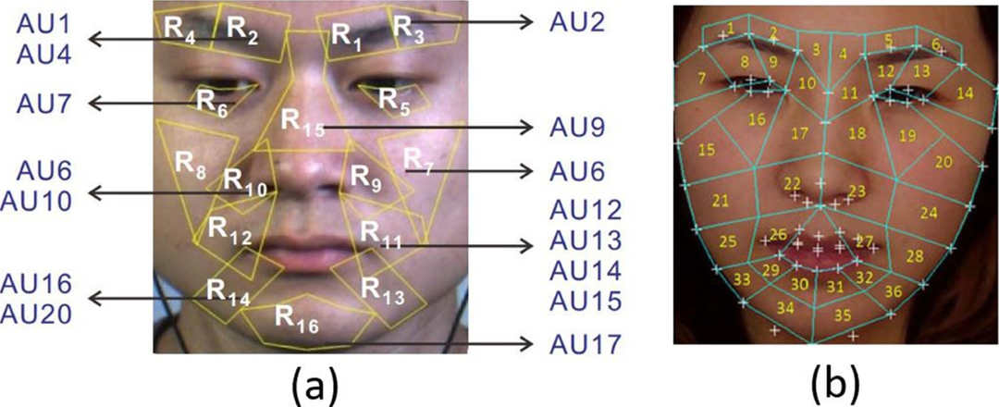
Expressions Modality Experiments
Action units (AUs) and emotions such as anger and fear were extracted using Py-Feat to model micro expressions.

Slide 25
Expressions Modality Results
Model Name | Best Parameters | Test Accuracy
SVM | kernel = ‘poly’, degree = 2, C = 1, coef0 = 0.5, gamma = ‘auto' | 54.17%
Decision Tree | Defaults | 62.50%
Random Forest | n_estimators = 1500, max_leaf_nodes = 10, max_depth=50 | 66.77%
XGBoost | Defaults | 75.00%

Slide 26
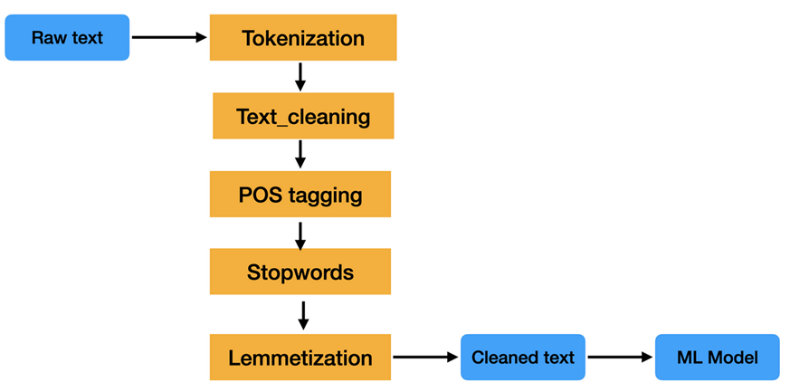
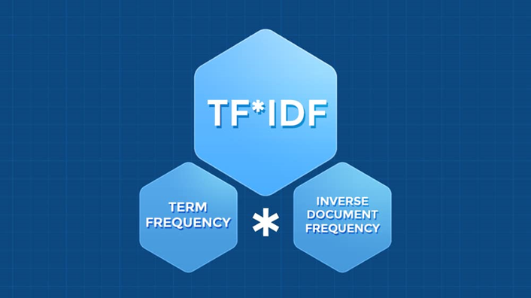
Text Modality Experiments
Transcripts were cleaned using an NLP pipeline and then vectorized using TF-IDF or Glove.

Slide 27
Text Modality Results
Model Name | Vectorizer | Parameters | Test Accuracy
SGD | TF-IDF | Defaults | 70.83%
SVM | TF-IDF | kernel = 'linear', C = 10 | 75.00%
ANN | TF-IDF | learning_rate = 0.01 | 79.17%
ANN | Glove 100d | learning_rate = 0.01 | 70.83%

Slide 28
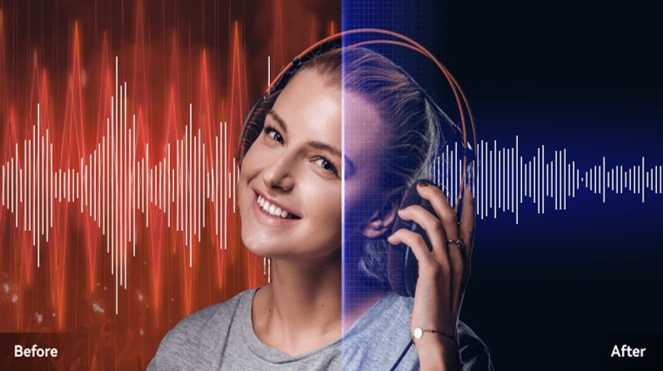
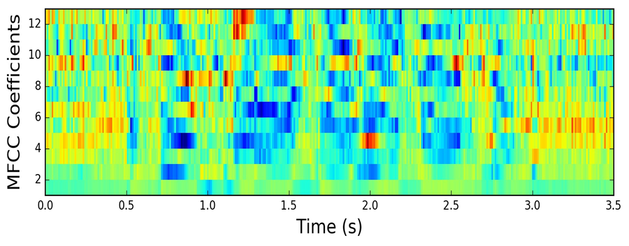
Audio Modality Experiments
STFT was applied to the audio signals to reduce noise artifacts, then MFCCs were extracted using Librosa.

Slide 29
Audio Modality Results
Model Name | Number of MFCCs samples | Test Accuracy
LSTM | 700 | 70.83%
GRU | 700 | 70.83%
Bi-LSTM | 700 | 79.17%
Bi-LSTM | 2000 | 75.00%

Slide 30
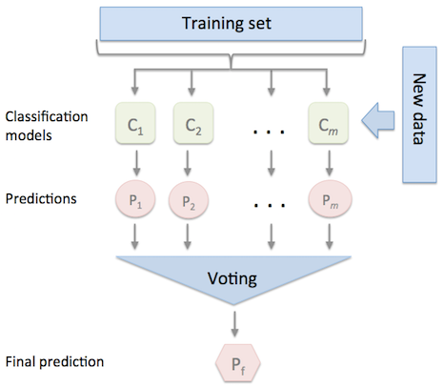
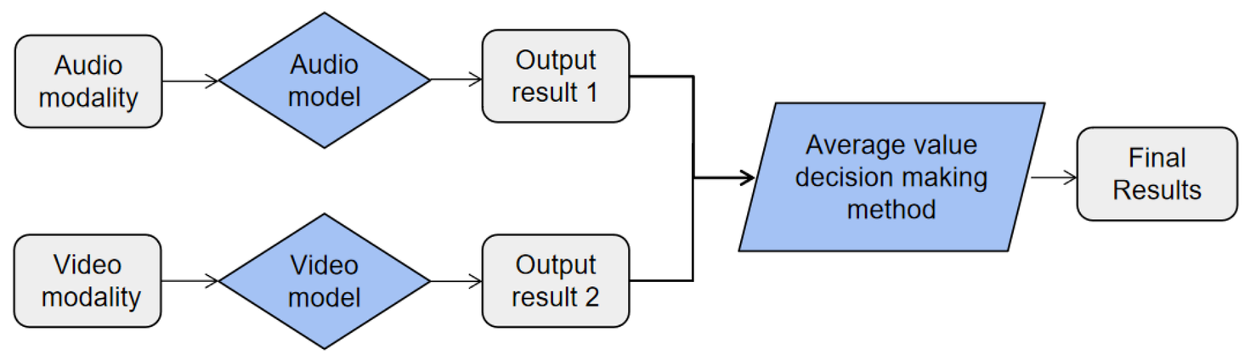
Multimodal Experiments
Predictions from single modalities were combined using late fusion techniques such as weighted average and majority voting.

Slide 31
Multimodal Results
Model Name | Fusion Type | Test Accuracy
A+V+T | Majority Voting | 95.83%
A+V+T | Weighted Average W = [0.15, 0.5, 0.35] | 91.66%
A+V+T+E | Majority Voting | 91.66%
A+V+T+E | Weighted Average W = [0.25, 0.25, 0.25, 0.25] | 87.50%

Slide 32
Competitive Analysis
Citation | Dataset | Methodolgy | Best Accuracy
Ahmed, Hammad Ud Din, et al. (2021) | Real Life Deception Detection Dataset | FACS with LSTM | 89.49%
Mathur, Leena, and Maja J. Matarić (2020) | Real Life Deception Detection Dataset | Visual and vocal features with AdaBoost | 84.00%
Krishnamurthy, Gangeshwar, et al (2018) | Real Life Deception Detection Dataset | Early fusion with visual, vocal and linguistic features | 96.14%
Proposed method | Real Life Deception Detection Dataset | Late fusion with visual, vocal and linguistic features | 95.83%

Slide 33

Short Demo

Slide 34
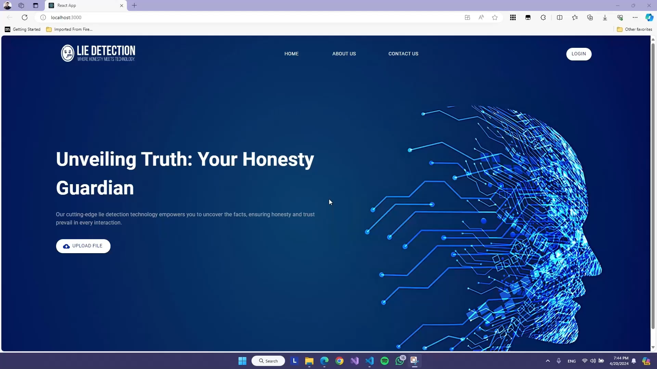

Slide 35
What’s Next ?
Explore early fusion techniques.
Enhance application functionality by implementing login and signup features.
Experiment with developing a reliable method for rPPG signal extraction.
Proceed with ongoing documentation efforts.

Slide 36
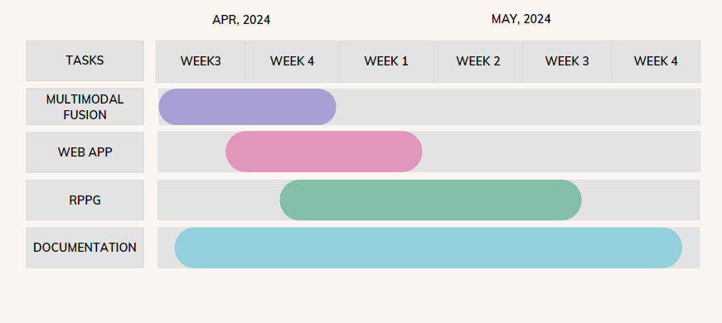
What’s Next ? (cont.)
Time plan (Gantt Chart)

Slide 37
Challenges
Challenge: In Real-Life Deception Detection Dataset, same subjects often reappear in multiple videos with consistent behavior, risking bias. Disproportionate gender representation in deceptive videos adds to potential bias with random dataset splits.
Solution: Manually create training and testing sets with new unseen subjects in the test set and ensure equal gender distribution to mitigate bias.

Slide 38
Challenges (cont.)
Challenge: Varied video quality, with some videos featuring multiple subjects, and others being unusable due to poor visibility or inadequate audio quality In Real-Life Deception Detection Dataset.
Solution: Edit videos to isolate individual subjects and remove completely unusable footage to ensure data quality.

Slide 39

Thank you very much!

